Slide 1

Content based SMS spam detection
Under the guidance of
Dr. Akshay Deepak
Assistant Professor
CSE Department
Ch. Manohar(1407029)
Sai Shashank(1407007)
Pooja Bharti(1407011)

Slide 2
Contents
Introduction
Objective
Proposed model
Work done so far
Conclusion and Future work

Slide 3
Introduction
What is spam?
spam is the use of electronic systems to send unsolicited bulk messages, especially advertising, indiscriminately.
Purpose spam –
Advertisements
Political SMS
Misleading SMS
Stock market advices

Slide 4
Introduction
Growth of mobile phone users and reduction of cost of messaging services had led to dramatically increased in SMS spam messages.
Filtering of these SPAM messages has done precisely using machine learning techniques.

Slide 5
Spam as a problem
Consumes computing resources and time
Reduces the effectiveness of legitimate advertising
Fraud
Identity theft
Consumer theft
Consumer perception
Global implications

Slide 6
Objective
we are proposing a model to detect sms spam
We are proposing an efficient translation-free recurrent neural architecture to perform multilingual SMS spam detection which actually remembers the context of SMS rather than frequency of words.

Slide 7
Data Collection
We require multi-lingual dataset, so we have collected our own sms which contains three different languages and mix of these three languages.
We also have standard English dataset obtained from kaggle.com.
Online source of standard English dataset - https://www.kaggle.com/uciml/sms- spam-collection-dataset

Slide 8
Dataset
Data | Type | Number | HAM | SPAM
English | Kaggle | 5572 | 4825 | 747
English | Self | 3745 | 2642 | 1103
Hindi | Self | 155 | 31 | 124
Mix | Self | 175 | 89 | 86
Telugu | Self | 520 | 505 | 15
Total |  | 10167 | 8092 | 2075

Slide 9
Base model flow chart
Data Collection
Data Labelling
Data Preprocessing
Bag of words
Machine Learning
Techniques
SPAM
HAM

Slide 10
Data Pre-processing in BoW
We have to preprocess the text for good performance of model.
First, we converted each letter to lowercase.
We removed unnecessary words like a, an, the ….. (stopwords)
And then we stemmed each word.
Above two step are done by using nltk module.
Thanks to nltk

Slide 11
Bag of Words
In this model, each message is represented by its unique words and each word frequency.
We created corpus of 510 highly occurring words and larger corpuses gave less accuracy.
We removed other words, retaining these 510 highly occurring words.

Slide 12
Bag of Words
We applied different machine learning techniques –
Support vector machine (svm)
Naive Bayes
Logistic Regression
K-Nearest Neighbors
Decision Tree
Random Forest

Slide 13
Bag of Words(accuracies)-
Model | Kaggle | Mix
SVM | 97.98 | 96.21
Naive Bayes | 98.42 | 93.09
Logistic Regression | 97.48 | 95.34
K-Nearest Neighbors | 93.10 | 92.89
Decision Tree | 96.62 | 95.26
Random Forest | 97.98 | 96.05

Slide 14
Bag of Words
We also stacking for improving model accuracy.
Stacking – it is the technique that combine multiple machine learning models. This improves accuracy.
We used tpot library for stacking purposes.
We applied different combinations machine learning techniques –
Gaussian and SVM
Thanks to tpot.

Slide 15
Bag of Words
Stacking accuracies -

Slide 16
Drawbacks of BoW
In this model all words are dumped in bag randomly.
In bag of words, it does not consider the order of words.
In this model, context of message is ignored.
For example :
Text 1 :
Text 2 :
This model treats above two sentences in similar manner.

Slide 17
Data Pre-processing
we converted each letter to lowercase.
And removed punctuations.

Slide 18
Word2Vec
We cannot compute words directly. So , we need numerical representation of words to compute.
So, we approached word2vec method for obtaining numerical representation of words.
Word2vec can give near numerical representation of similar words.

Slide 19
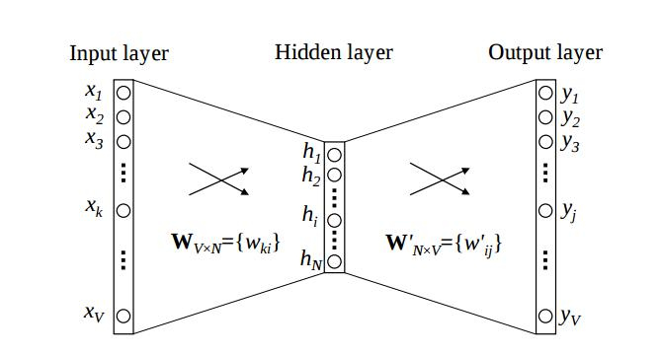
Building word2vec
Word2vec is simple 3-layer Neural Network.

Slide 20
Building word2vec
Sample SMS: thank you for using state bank internet banking.
First, we should build dictionary of words. We have taken total words in the dataset.
Sample dictionary:
thank
you
…….
…….
using
state
…….

Slide 21
Building word2vec
Sample SMS: thank you for using state bank internet banking.
We taken previous word, next word for each word for training into word2vec.
So, combinations for obtained from above SMS,
[ thank , you ]
[ you , thank ]
[ you , for ]
………
………
………

Slide 22
Building word2vec
Take one of the above combination ,
[ thank , you ]
Here context word is ‘thank’ and target word is ‘you’.
We take one hot representation of ‘thank’ as input into neural network and output is one hot representation of ‘you’.
We trained every combination of words.

Slide 23
Building word2vec
For numerical representation of ‘thank’ , we inputted one hot representation of ‘thank’ values of hidden layer is taken for representation word ‘thank’.
And we obtained numerical representation of all words.
We used genism module for generating word2vec.
Thanks to genism.

Slide 24
Recurrent Neural Network
The sequence of words in a sentence matters the meaning of sentence.
RNN is useful in dealing with sequence in information.
Use cases:
Sentiment classification
Image captioning
Language translation

Slide 25

Machine Learning Algorithms
RNN
Recurrent Neural network is a class of artificial neural network where connections between units form a directed graph along a sequence .A RNN has loops in them that allow information to be carried across neurons while reading in input.

Slide 26
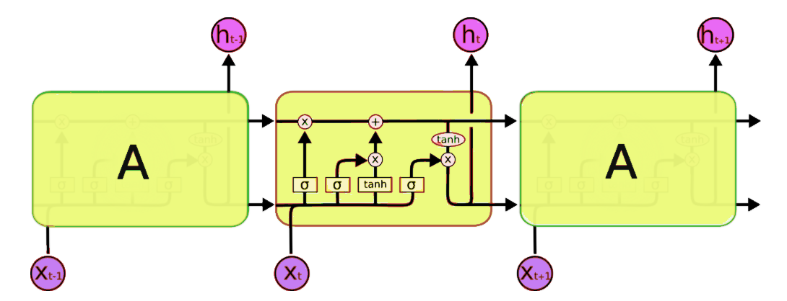
Long-Short Term Memory
Long Short-Term Memory (LSTM) Networks are special kind of RNN, capable of learning long- term dependencies.
Introduced by Hocheiter and Scmidhuber.
Remembers information for long periods of time is practically their default behaviour.

Slide 27
LSTM Network
We inputted each word in message into the network in sequence.
We took output at end of the network.

Slide 28
Model
Our model is LSTM network connected to 120 nodes layer at the end.
And this 120 nodes layer is connected to 2 nodes layer.
These 2 nodes at the end determine whether a SMS is spam or not.
We ran model 7 epochs with batch size 50

Slide 29
Model Based on Existing Method
In the work of Gomez Hidalgo et al. in SMS spam detection ,among various machine learning classification techniques of email spam filtering , Bayesian filtering techniques can be effectively used for SMS spam detection.
So we applied different machine learning algorithm like SVM ,Naïve Bayes ,decision tree etc. on Kaggle dataset as well all ( kaggle + self)collected dataset.
In our case also Naïve Bayes gives the high accuracy.

Slide 30
Accuracy
Model | Kaggle | Mix
SVM | 97.98 | 96.21
SVM_RBF_KERNEL | 93.96 | 91.71
Naïve Bayes | 98.42 | 93.09
Logistic Regression | 97.48 | 95.34
K-Nearest Neighbors | 93.10 | 92.89
Decision Tree | 96.62 | 95.26
Random Forest | 97.98 | 96.05

Slide 31
Proposed Model
Data Collection
Data Labelling
Data Preprocessing
word2vec
LSTM
SPAM
HAM

Slide 32
Motivation
To deal with the actual context of message is our main motivation to develop this model.
For our experimental purposes we have tried out all the classification models.
The Accuracies are pretty high but these models are based on frequency of words.
For an example, "I will BUY you a FREE drink, come to my place." this is a HAM message, but if we go based on keywords, some classification models may detect it as SPAM.
In this project, we proposed model that deals with the actual context, using WordtoVec followed by LSTM(Long Short Term Memory).

Slide 33
Conclusion and Future Work
Adding Indian SMS dataset and implementing using Deep Learning algorithms like RNN etc.

Slide 34
Sources
Spam Detection Using Text Clustering by Minoru Sasaki
Evaluating the efficacy of android applications by Akshay

Slide 35
Contribution
Manohar-RNN ,Coding
Shashank –Data Collection ,Stacking
Pooja-Data Collection ,SVM , Naive Bayes

